Slide 1




CODE BASICS
STRATEGIC INSIGHTS FOR OTT DOMAIN
Manwith Modala

Slide 2
AGENDA
ABOUT PROJECT
PRIMARY RESEARCH OUTCOMES
KEY FINDINGS
KEY METRICS
FURTHER ANALYSIS AND RECOMMENDATIONS
CONCLUSION

Slide 3
about project
BASIC DETAILS :
This project aims to analyze two Ott platforms which happens to merge.
The goal was to optimize pricing, enhance engagement, and establish a strong market position post-merger.
TABLES :
WE HAVE 2 SQL DATABASES THAT HAVE TO BE ANALYZED AND EACH HAVING 3 TABLES SEPARATELY.
THE TABLES ARE SUBSCRIBER TABLE, CONTENT TABLE AND CONTENT CONSUMPTION TABLE.
KEY OBJECTIVE:
WITH THE RISE OF OTT CONSUMPTION IN INDIA, THIS PROJECT FOCUSES ON ANALYZING THE PERFORMANCE OF TWO MAJOR OTT PLATFORMS MERGING.
THE GOAL IS TO UNDERSTAND USER BEHAVIOR, REVENUE TRENDS, ENGAGEMENT LEVELS, AND PRICING STRATEGIES TO MAXIMIZE PROFITABILITY AND MARKET REACH.

Slide 4
key findings
USER ENGAGEMENT & CHURN:
13.6% CHURN RATE OBSERVED, WITH THE MAJORITY OF DOWNGRADES FROM PREMIUM TO FREE.
Inactive users had low watch time and longer inactivity periods, highlighting engagement gaps.
📈 REVENUE TRENDS & PRICING IMPACT:
FREE MODEL DRIVES HIGH USER BASE BUT LOWERS REVENUE; BALANCED PREMIUM RETENTION IS KEY.
Revenue calculations reflected the exact time users spent on plans, ensuring accurate financial insights.
Evaluated user movement between plans and their impact on overall engagement.

Slide 5
OUTCOMES ->
Seperated two Ott platforms for better understading of their growth, correlation between inactive users and their watch time, content consemption.
Revenue analysis had a seperate page for comparing both platforms based on their total revenue, revenue upgrades and downgrades.
And another page for comparing both platforms at a single page.
And another page for recommendations and some valuable strategies.

Slide 6
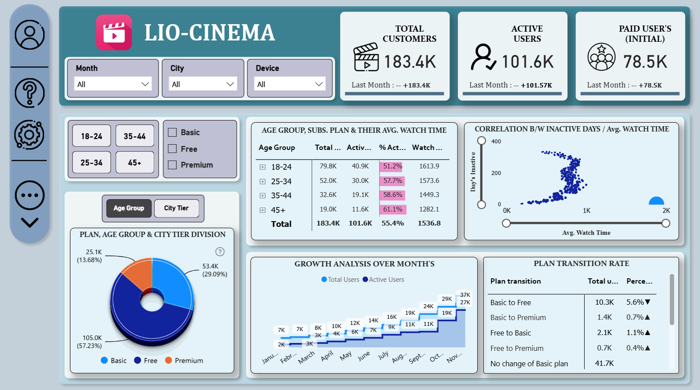

Slide 7
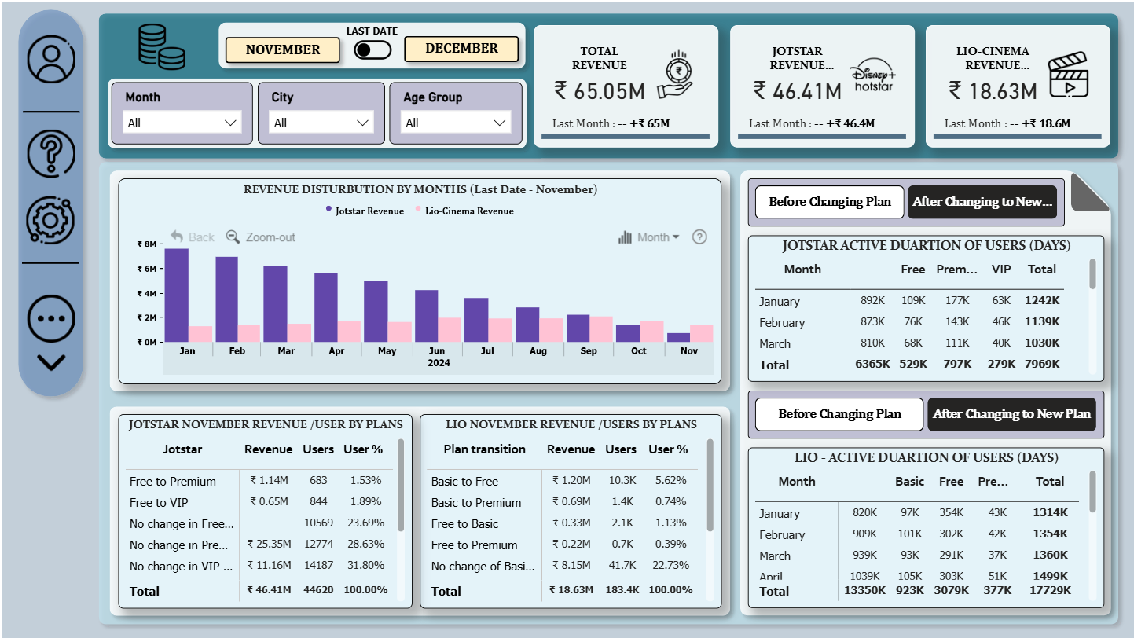

Slide 8
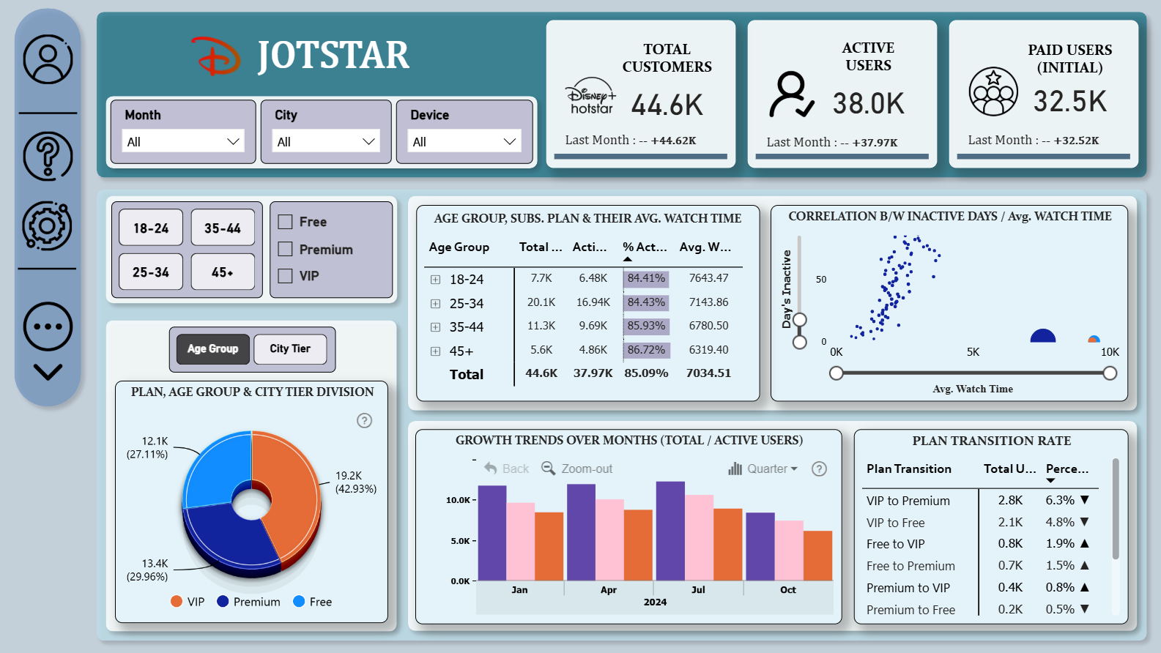

Slide 9
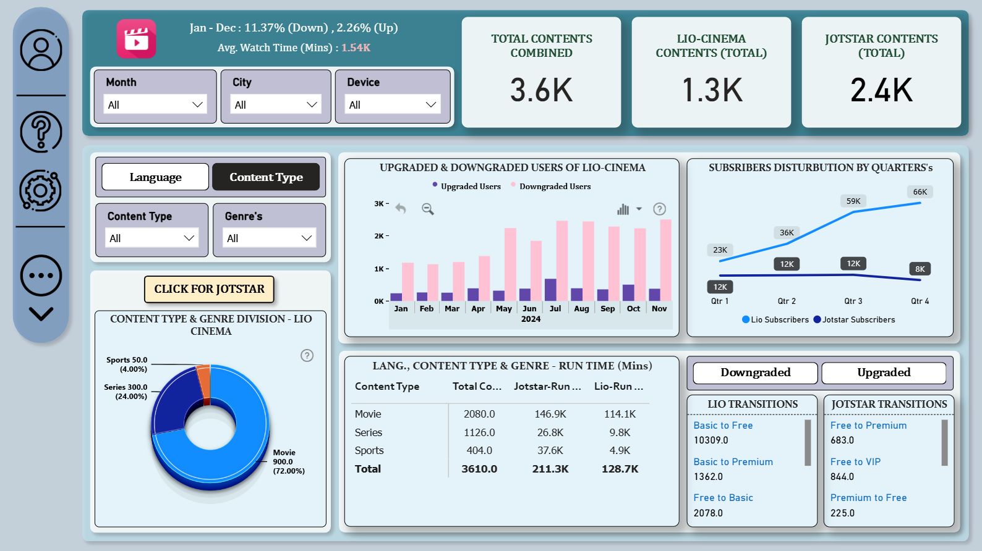

Slide 10
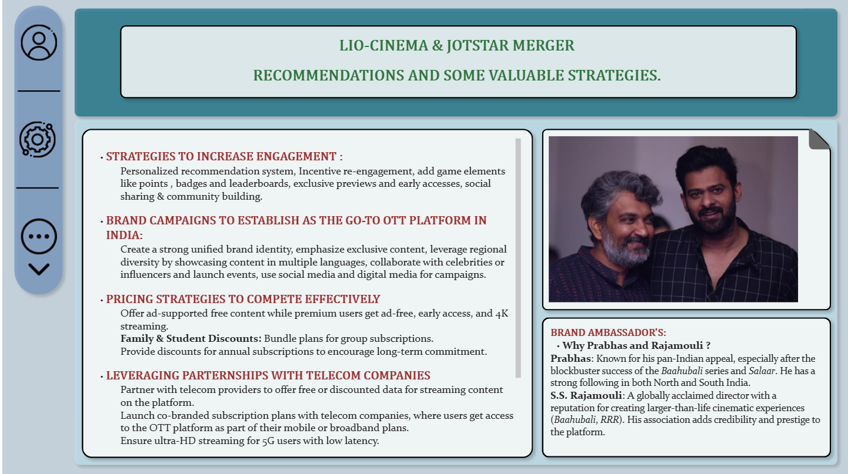

Slide 11
Key metrics
📌 Active Users (%) – Monthly active users (MAU) vs. total subscribers.
📌 Inactive Users (%) – Users with minimal/no engagement for the past 30+ days.
📌 Average Watch Time (hrs/user) – Time spent per user on the platform.
📌 Retention Rate (%) – Users who continued their subscription over time.
📌 Churn Rate (%) – Users who canceled or downgraded their plans.
📌 Total Subscribers – Number of users across all plans.
📌 Plan Transition Rate (%) – % of users upgrading/downgrading their plans.

Slide 12
CODE BASICS
CONCLUSION
The OTT Platform Merger Analysis provided critical insights into user engagement, subscription trends, and revenue performance. By analyzing upgrades, downgrades, and user retention patterns, we identified key areas for improvement and growth.
Key Takeaways:
Enhancing Engagement: Strategies were proposed to convert inactive users into active subscribers through personalized recommendations and targeted campaigns.
Optimizing Revenue: A refined pricing strategy was suggested to balance affordability and profitability while encouraging plan upgrades.
Expanding Reach: Potential telecom partnerships were explored to boost subscriber acquisition in both urban and rural markets.
AI-Driven Personalization: Leveraging AI and machine learning to improve content discovery, enhance recommendations, and drive higher watch time.
Brand Positioning: Suggested influencer-driven marketing campaigns and a strong brand ambassador to establish the merged platform as India's leading OTT provider.
This analysis serves as a data-driven roadmap for improving platform performance, increasing user retention, and strengthening market competitiveness in the evolving OTT landscape.

Slide 13


Thank you

